Slide 1




MobileNAV Configuration
Configure MobileNAV devices from AL: demo and handover
Brad Fullwood
Business Applications Development
16 October 2026
Notes:
Welcome. This is ten minutes on MobileNAV, MULTISOFT’s mobile client for Business Central on warehouse scanners, and the framework that configures it from AL. Each slide shows what you would do by hand today and what the framework does instead, and the purple strip at the bottom says what I open next. By the end you should know what you can build, how much hand setup it removes and where to start without asking me. Before starting: VS Code open on the repo workspace, and Brave open on the CDX demo sandbox, CRONUS UK Ltd.

Slide 2
Today’s 10 minutes
1
Why
5
Doctor finds and fixes drift
0.5 min
1.5 min, live
2
Buttons: three ways become one
6
Start a new provider
1.5 min, VS Code
0.5 min, live
Before and after: fields, dialogs, pictures, own pages, install, live
7
Developer workflow: a new field
3
1 min
2.5 min, about 30 seconds each, skip any
Ship it
8
4
See it without a scanner
0.5 min
1 min, live
Your first provider and questions
9
1 min
Show: nothing, stay on the slide.
MobileNAV Configuration, 16 October 2026
2
Notes:
This is the plan for the next ten minutes, and the deck follows it. First why MobileNAV setup by hand is a problem, then buttons in VS Code, then a run of before and after slides with real hand-built code, about 30 seconds each, any of which I can skip. Then three live parts in the sandbox: the emulator, the Doctor, and the New provider wizard, followed by the developer workflow for a new field. I finish with shipping and CI, a summary table, and where to start. Click path: none, move to the next slide.

Slide 3
Why: MobileNAV setup by hand
What it takes today to put one new field on a scanner page
By hand today
With the framework
Find the right rows in about a dozen MobileNAV admin pages
Set the field’s Importance, or MobileNAV hides it behind “show more”
Add a row for every profile, switch on Page Update, refresh the page metadata
Repeat it all in test and live. None of it is in source control or reviewed
One provider codeunit in AL does it
Reviewed in a pull request like any other change
Applied the same way in every environment
Show: nothing, stay on the slide.
MobileNAV Configuration, 16 October 2026
3
Notes:
Take one new field on a scanner page. By hand you find the right rows across about a dozen MobileNAV admin pages, set the field’s Importance or MobileNAV hides it behind “show more”, add a row for every profile, switch on Page Update so the device accepts edits, and refresh the page metadata. Then you do it all again in test and in live, and none of it is in source control or reviewed. With the framework one provider codeunit does it, it goes through a pull request, and it applies the same way everywhere. Click path: none, stay on the slide.

Slide 4
Add a button: three ways by hand
By hand today: the plumbing depends on the page
A MobileNAV page whose table MobileNAV has functions for (40 tables): subscribe to that table’s own MobileNAV event. The signature differs per table, and the code dispatches on service name, then control name.
A MobileNAV page whose table has none: write a codeunit and publish it, from an install codeunit, as a web service with the same name as the page’s web service.
A page of your own: publish the page and a codeunit under one name, name the entry parameter exactly “Key” because MobileNAV calls it that, and wire it in MobileNAV’s admin pages or a partial XML import.
Get it wrong and the device shows Method "..." is invalid! with no error in Business Central.
[EventSubscriber(ObjectType::Codeunit, Codeunit::"MobileNAV Page Functions", 'OnSalesLineExtFunc', '', false, false)]
local procedure OnSalesLineExtFunc("Key": Record "Sales Line"; ServiceName: Text[100]; FieldName: Text[75])
begin
if ServiceName = 'MNSalesOrderLine' then
case FieldName of
'PostShip': ...
'PostInvoice': ...
end;
end;
UpdateOrCreateWS(WebService."Object Type"::Codeunit, 'MNWarehousePutaway', Codeunit::"Cust MN Page Functions");
With the framework: the same route on every page. Next slide.
Show: nothing, stay on the slide.
MobileNAV Configuration, 16 October 2026
4
Notes:
By hand, how you wire a device button depends on the page, and you have to know which of three cases you are in. If MobileNAV has functions for the table, one of 40, you subscribe to that table’s own event, and the first snippet shows the dispatch on service name, then control name. If it has none, you publish your own codeunit as a web service with the same name as the page’s service, which is the second snippet. For a page of your own you publish page and codeunit under one name, call the parameter exactly “Key”, and wire it in the admin pages. Get any of it wrong and the device says Method is invalid, with nothing in Business Central. Then theres the fact if you havent logged into MobileNAV on a device yet when you try and assign the function it will give a webservice error.

Slide 5
Add a button: one way now
By hand today: three patterns, and a wrong one shows Method "..." is invalid! on the device.
With the framework: the same on every page
Button('ExampleFlagReorder') in the provider and one subscriber to “BJF MN Function Router”.OnPageFunction
The framework picks the route: MobileNAV’s functions for its 40 tables, its own companion for the 78 others, your codeunit when you declare PageFunctions()
A function name that does not exist stops the apply with a message, before anyone taps
// Level 2
Configuration.Page(Page::"MobileNAV Item")
.Field('ExampleReorderFlagged')
.Button('ExampleFlagReorder');
[EventSubscriber(ObjectType::Codeunit, Codeunit::"BJF MN Function Router", OnPageFunction, '', false, false)]
local procedure OnPageFunction(PageId: Integer; ControlName: Text[75]; FunctionRecord: RecordRef;
var FieldControlFactory: Codeunit "MobileNAV Object Functions")
begin
if (PageId <> Page::"MobileNAV Item") or (ControlName <> 'ExampleFlagReorder') then
exit;
FunctionRecord.SetTable(Item);
Item.Validate("Example Reorder Flagged", true);
Item.Modify(true);
FieldControlFactory.FcSetToastMessage(Item, 'Flagged for reorder');
end;
Show: VS Code, ExampleMNProvider.Codeunit.al line 75, then src/Item/ExampleItemHandler.Codeunit.al line 16.
MobileNAV Configuration, 16 October 2026
5
Notes:
With the framework a button is the same on every page. You declare Button in the provider, which is level 2 of the example, and write one subscriber to OnPageFunction on “BJF MN Function Router”, filtered on page and control name. The framework picks the route itself: MobileNAV’s own functions for its 40 tables, the framework’s companion codeunit for the 78 others, or your codeunit when you declare PageFunctions. If a function name does not exist, the apply stops with a message before anyone taps the button. Click path: VS Code, ExampleMNProvider.Codeunit.al line 75, then src/Item/ExampleItemHandler.Codeunit.al line 16.

Slide 6
Fields that do not show up
By hand today
MobileNAV hides a new field behind “show more” unless its Importance is set, hides it in every wizard stage by default, needs a row for every profile, and shows no tile unless the page opts in
Groups are marker rows placed by position in an exported XML list or created via the UI.
<Field Name="_SYSTEM_End" GroupEnd="true" Category="SYSTEM" />
<Field Name="_SYSTEM_Start" GroupStart="true" Category="SYSTEM" />
<Field Name="File_Name" Visible="true" Editable="false" VisibleAsFilter="false" MobileType="Normal" />
With the framework
Field() is visible, standard importance and in every profile by default
Groups and order are declared
The Doctor’s “Fields & Importance” and “Groups & Order” checks report any row that no longer matches
.OrderAsDeclared()
.Group('EXAMPLE')
.Lookup('ExampleDefaultBin', Page::"MobileNAV Bin", 'Code', 'Description')
.EndGroup()
Show: nothing.
MobileNAV Configuration, 16 October 2026
6
Notes:
About 30 seconds. You can skip any of slides 6 to 11 if time is short, the deck is shared afterwards. By hand a new field often does not show up: MobileNAV hides it behind “show more” unless Importance is set, hides it in every wizard stage, needs a row per profile, and groups are marker rows placed by position in an XML export, like the snippet. With the framework Field() is visible, standard importance and in every profile by default, and groups and order are declared in code. The Doctor’s Fields and Importance and Groups and Order checks report any row that no longer matches. Click path: none.

Slide 7
Dialogs, colours and hiding fields while the user works
By hand today
Business Central’s Confirm cannot be answered from the device session, so one project suppresses it with an event subscriber
A dialog goes through a hidden FieldControl field that must exist in the AL page, the handler and the XML export, and the page clears it on every read
Hiding a field depends on code that writes into that field on every record
field(FieldControl; FieldControl) { Visible = false; }
trigger OnAfterGetRecord() begin FieldControl := ''; ... end;
if (Rec."Item No." = '') or (Rec.Quantity = 0) then
MobileNAVObjectFunctions.SetFieldHidden(FieldControl, 'Register');
With the framework
FieldControl('FieldControl') declares the channel, one subscriber to “BJF MN Field Control”.OnCalculateFieldControl answers it
Rules that hide or colour fields are declared, and MobileNAV runs them
.Layout('INSTOCK', 'In stock')
.WhenValue('Inventory', Enum::"BJF MN Comparison"::Greater, '0')
.HidesField('ExampleFlagReorder')
.Layout('NOSTOCK', 'No stock')
.WhenValue('Inventory', Enum::"BJF MN Comparison"::LessOrEqual, '0')
.ValueColor('Inventory', Enum::"BJF MN Color"::CardMandatoryCaption)
Show: nothing.
MobileNAV Configuration, 16 October 2026
7
Notes:
About 30 seconds, skippable, the deck is shared afterwards. By hand, a Confirm cannot be answered from the device, so one project suppresses it with a subscriber. Dialogs go through a hidden FieldControl field that has to exist in the AL page, the handler and the XML export, and hiding a field means writing into that field on every record, as in the snippet. With the framework FieldControl() declares the channel and one subscriber to OnCalculateFieldControl answers it. Rules that hide or colour fields are declared with Layout, and MobileNAV runs them itself. Click path: none.

Slide 8
Photos, signatures and PDFs
By hand today
A capture arrives as Base64 text with MobileNAV’s IMP, DEL and EXP actions
Binding a Media field directly gives “No file specified” on the device
A PDF for the device is converted to Base64 by hand. One project repeats this block 4 times
Six projects carry their own Base64 handling
if (Action = 'DEL') or ((Action = 'IMP') and (Base64Result.Length() = 0)) then
Error(SignatureCannotBeDeletedErr);
MNObjFunc.HandleBase64EncodedData("Key", FieldName, Action, Base64Result);
Report.SaveAs(Report::"Cust Pallet Label", '', ReportFormat::Pdf, OStream, RecRef);
Base64Text := Base64.ToBase64(IStream);
Base64Result.AddText(Base64Text);
With the framework
The photo is stored in a normal Media field
The Example Tests app checks photo, signature and PDF
Example levels 12 and 15, FunctionName lines left out for space
.Button('Photo')
.MobileType(Enum::"BJF MN Mobile Type"::Image)
.FunctionType(Enum::"BJF MN Function Type"::BLOB)
.Button('PrintCount')
.MobileType(Enum::"BJF MN Mobile Type"::PDF)
.FunctionType(Enum::"BJF MN Function Type"::"Generated BLOB")
Show: nothing.
MobileNAV Configuration, 16 October 2026
8
Notes:
About 30 seconds, skippable, the deck is shared afterwards. By hand, a photo or signature arrives as Base64 text with MobileNAV’s IMP, DEL and EXP actions, and binding a Media field directly gives “No file specified” on the device. A PDF for the device is converted to Base64 by hand, one project repeats that block four times, and six projects carry their own Base64 handling. With the framework a button declares its mobile type and function type, the photo lands in a normal Media field, and the Example Tests app checks photo, signature and PDF. Click path: none.

Slide 9
A page of your own: tile, link and wizard
By hand today
With the framework
MobileNAV Administration
Configured Pages
MobileNAV ReleasedProdOrder
Refresh page data
line set to Visible = true
line set to Display in Menu = true
add Related Page
Filter: Prod_Order_No = Field = No
Configuration Handling
Import included XML, which contains the partial config for this page
Example level 4, label constants inline, two lines left out
Configuration.Page(Page::"Example Stock Count")
.Publish('ExampleStockCount')
.ShowInMenu()
.MineOnly('UserId')
.Scan('ItemNo')
.Lookup('BinCode', Page::"MobileNAV Bin", 'Code', 'Description')
.Field('CountedQuantity').Editable().Quantity(1)
.Wizard().AutoNext()
.Stage('SCAN', 'Scan').Show('ItemNo').Show('BinCode')
.Stage('COUNT', 'Count').Show('CountedQuantity');
Configuration.Page(Page::"MobileNAV Item")
.Link('ExampleStockCounts', Page::"Example Stock Count", 'ItemNo', 'No.');
Wizard state is kept in a buffer table of its own, and per-user rows in a temporary data table of its own.
Show: VS Code, MobileNAV Configuration Example/README.md line 30, the levels table.
MobileNAV Configuration, 16 October 2026
9
Notes:
About 30 seconds, skippable, the deck is shared afterwards. On the left is the recipe from a real project README for putting one page of your own on the device: ten steps through MobileNAV’s admin pages, ending in a partial XML import. That project also keeps wizard state in a buffer table of its own and per-user rows in a temporary table of its own. On the right is level 4 of the example: the page is published, shown as a menu tile, filtered to the device user, has a scan input, a lookup and a two-stage wizard, and a link from the item page. Click path: VS Code, MobileNAV Configuration Example/README.md line 30, the levels table.

Slide 10
Install, upgrade and web services
By hand today
With the framework
One project’s install codeunit registers 18 web services in OnInstallAppPerDatabase. It runs on a fresh install only, so an upgrade never creates a new service and a button does nothing on the device
The shared helper deletes clashing Tenant Web Service rows without a message
Another project ships an InstallWebServices.xml that its README says installs itself. Nothing reads it
Publish() and PageFunctions() are part of the provider, and the apply registers them
The framework fingerprints the provider, so a changed declaration shows Outdated until it is applied
A web service another app owns stops the apply and names both codeunits
The Doctor’s “Services & Web Services” check has Apply Fix
“The install codeunit creates these, but OnInstallAppPerDatabase only fires on a fresh install, not on an upgrade.”
Show: nothing.
MobileNAV Configuration, 16 October 2026
10
Notes:
About 30 seconds, skippable, the deck is shared afterwards. By hand, one project registers 18 web services in OnInstallAppPerDatabase, which runs on a fresh install only, so after an upgrade a new button does nothing on the device. Their own note says so. Its shared helper also deletes clashing web service rows without a message, and another project ships an XML file of web services that nothing reads. With the framework Publish() and PageFunctions() are in the provider and every apply registers them, a changed provider shows Outdated until applied, a web service owned by another app stops the apply and names both codeunits, and the Doctor can fix missing services. Click path: none.

Slide 11
Getting it to live and keeping it right
By hand today
With the framework
“None of this is in source control, it has to be applied to prod by hand, matching what was configured in the sandbox.”
The provider goes through a pull request and applies the same rows in every environment
Snapshots export, import and diff a configuration between companies
The Doctor runs nightly and reports hand edits
“The rest of the sandbox setup was typed into MobileNAV’s own pages and does not travel with the providers.”
Still true with the framework
“The 28 and 29 September changes show someone is still editing the sandbox.”
Devices download a new configuration only when the user logs out and in. The apply must run as a licensed user, because MobileNAV refuses the device handover for a delegated administrator. The provider shows Outdated until then.
Show: nothing.
MobileNAV Configuration, 16 October 2026
11
Notes:
About 30 seconds, skippable, the deck is shared afterwards. These three notes are from real projects: the setup is not in source control and is copied to production by hand, part of it lives only in MobileNAV’s own pages, and someone was still editing the sandbox weeks later. With the framework the provider goes through a pull request and applies the same rows everywhere, snapshots export, import and diff a configuration, and the Doctor reports hand edits every night. Two things stay true: devices only pick up a new configuration after the user logs out and in, and the apply has to run as a licensed user, because MobileNAV refuses the handover for a delegated administrator. Click path: none.

Slide 12
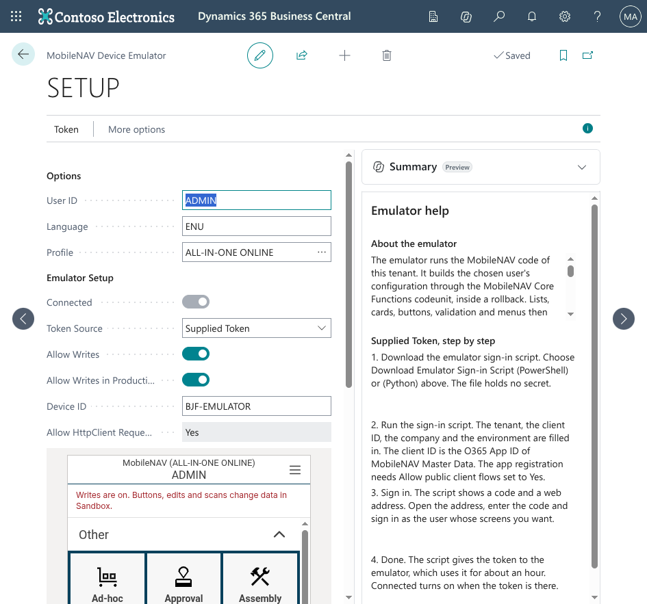
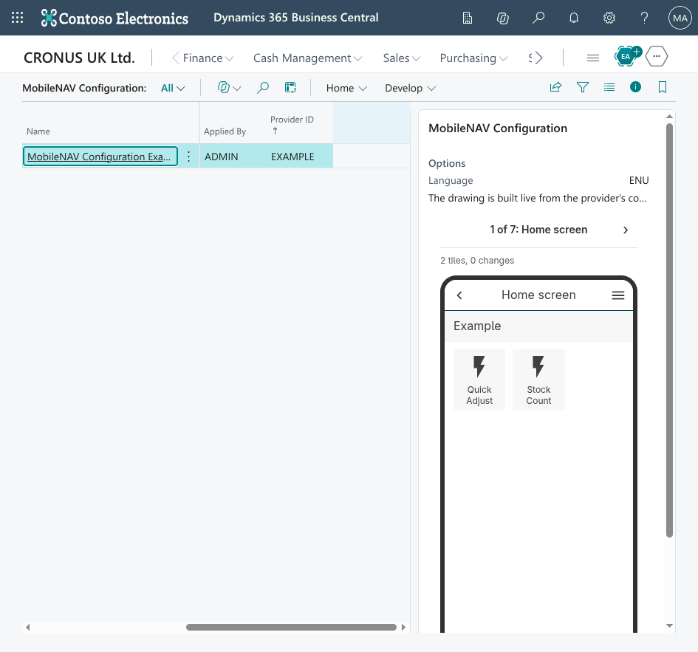
See it without a scanner
By hand today
Deploy, then pick up a scanner or start an Android emulator
Log out of the MobileNAV app and in again to download the configuration
Then look
With the framework
MobileNAV Emulator draws the device screens as a phone inside Business Central, from the live configuration
Device Preview draws every page of a provider in a factbox and as an HTML download
MobileNAV Emulator, inside BC
Device Preview factbox on MobileNAV Configuration
Show: Brave, MobileNAV Configuration, select EXAMPLE, MobileNAV Emulator, open an item.
MobileNAV Configuration, 16 October 2026
12
Notes:
To see a change by hand you deploy, pick up a scanner or start an Android emulator, log out of the MobileNAV app and in again so it downloads the configuration, and then look. The MobileNAV Emulator does this inside Business Central: it draws the device screens as a phone from the live configuration. Device Preview draws every page of a provider in the factbox on the MobileNAV Configuration page, and Download preview HTML gives the same drawing as a file. The example is already applied in the sandbox, so do not press Apply. Click path: Brave, search MobileNAV Configuration, select EXAMPLE, MobileNAV Emulator, open Items, open an item and point at Item Category Code, Inventory, Notes and the Flag for Reorder button.

Slide 13
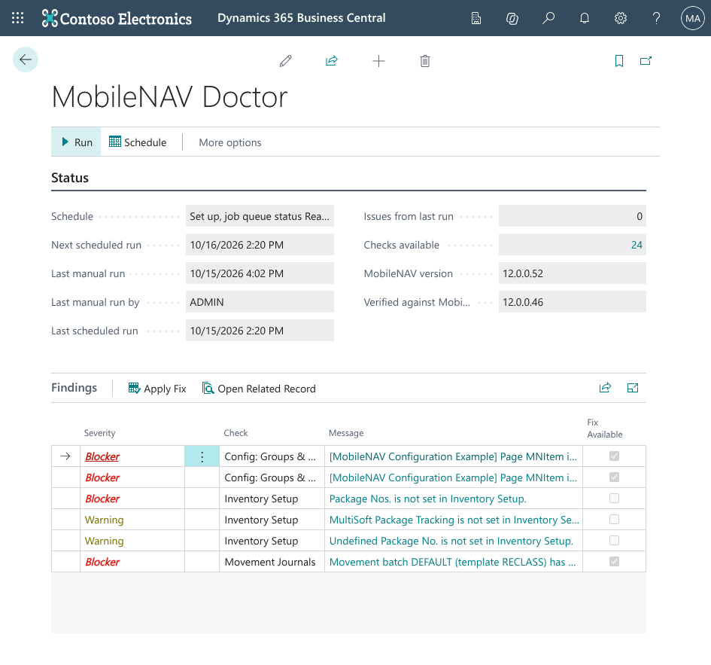
Doctor finds and fixes drift
By hand today
Nobody checks
Someone edits a row in an admin page and a field disappears on the scanner
A user reports it later
With the framework
MobileNAV Doctor runs 18 checks, 24 with the WMS satellite installed as in this sandbox: services, fields, profiles, page rules, wizards, links, groups and order, layouts, captions, line formats, MobileNAV version, apply state and more
Each finding is a Blocker or a Warning, many have Apply Fix
Runs nightly as a job and through an API. The WMS satellite app adds checks for WMS MobileNAV
“Checks available 24”: the sandbox has the WMS satellite. Live finding: “Page MNItem is not laid out as declared: control ExampleDefaultBin should be at position 6 but is at 7.”
Show: Brave, MobileNAV Doctor, Run, point at the two MNItem Blockers, Apply Fix, Run again, they are gone.
MobileNAV Configuration, 16 October 2026
13
Notes:
By hand nobody checks MobileNAV setup. Someone edits a row in an admin page, a field disappears on the scanner, and a user reports it later. MobileNAV Doctor runs 18 checks against what the providers declare, 24 with the WMS satellite, which is why the sandbox page says “Checks available 24”, and each finding is a Blocker or a Warning, many with Apply Fix. It runs nightly as a job and through an API, and the WMS satellite app adds checks for WMS MobileNAV. The sandbox has real drift on page MNItem right now. Click path: Brave, MobileNAV Doctor, Run, point at the two MNItem Blockers (ExampleDefaultBin at position 7 instead of 6, and a marker row of group EXAMPLE out of order), select one, Apply Fix, Run again, the MNItem findings are gone.

Slide 14
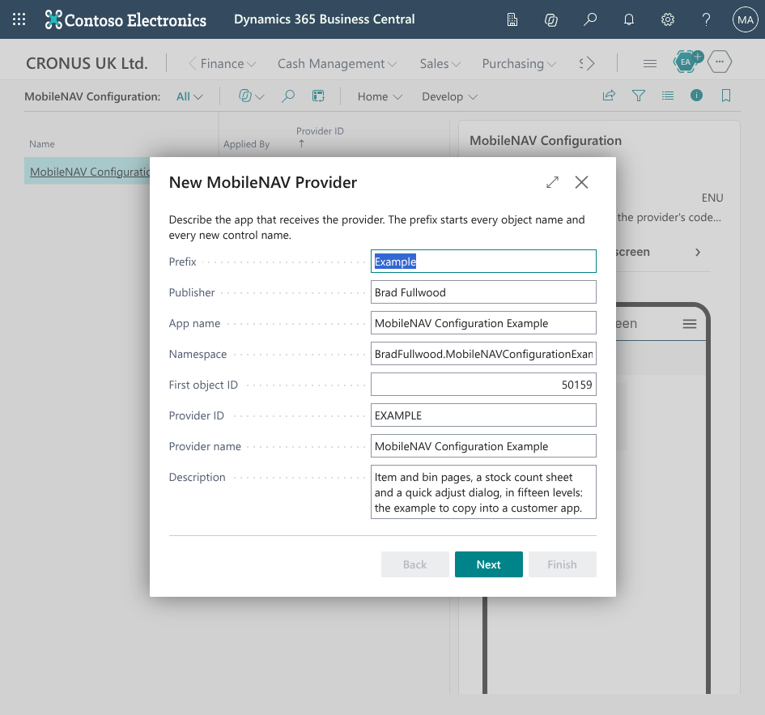
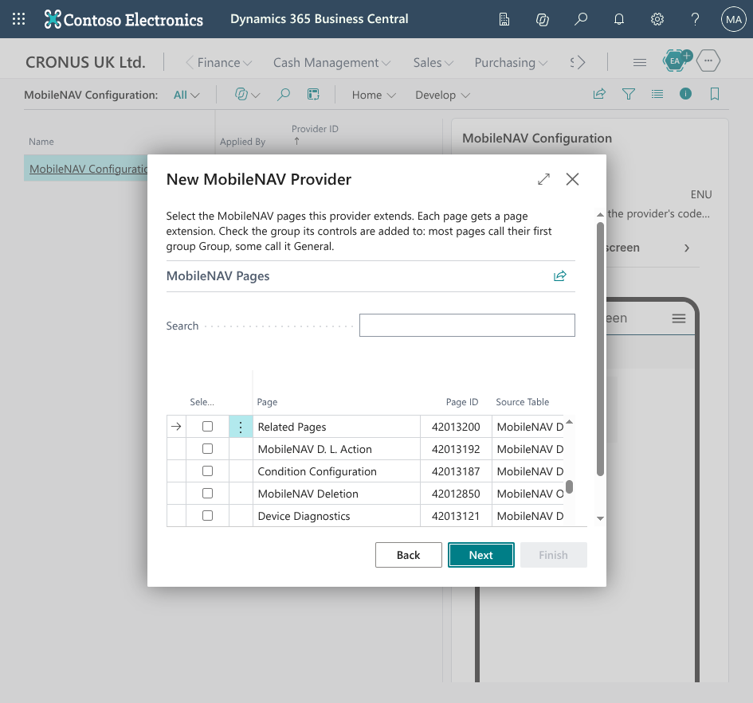
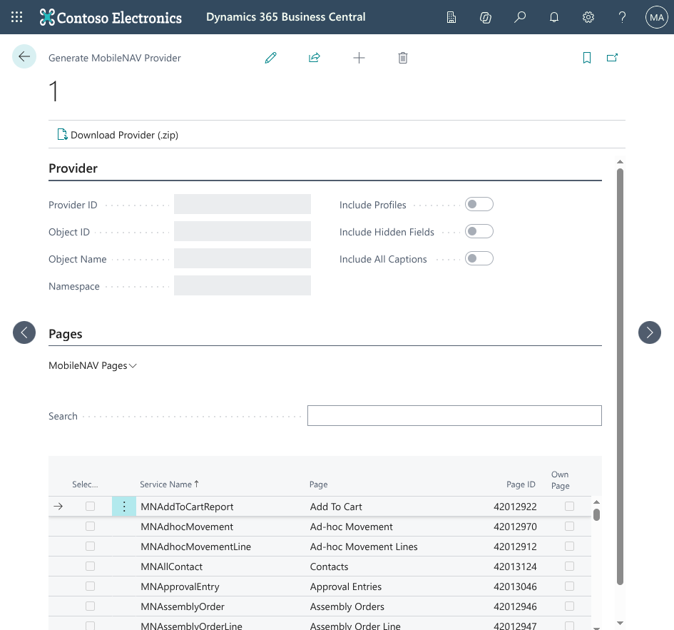
Start a new provider
By hand today
With the framework
Start from an empty codeunit
Or read an existing hand setup back out of the admin pages
New provider wizard: prefix, publisher and pages, then fields and buttons, then a starter app as a zip
Generate provider from pages turns hand setup into provider AL, one page at a time
New provider, step 1: describe the app
New provider, step 2: pick the pages
Generate provider from pages
Show: Brave, MobileNAV Configuration, Develop, New provider, first step only.
MobileNAV Configuration, 16 October 2026
14
Notes:
By hand a new provider starts from an empty codeunit, or from reading an existing hand setup back out of the admin pages. The New provider wizard asks for the prefix, publisher and pages, lets you pick fields and buttons, and downloads a starter app as a zip. Generate provider from pages goes the other way: it turns a MobileNAV setup done by hand into provider AL. That means an existing app can move to code one page at a time. Click path: Brave, MobileNAV Configuration, Develop, New provider, show the first step only, then cancel.

Slide 15
No need to write code manually: a new field on the device
Step 1, you write
1
Add the field in a table extension in your app
tableextension 50100 "ABC Item" extends Item
{
fields
{
field(50100; "Shelf Note"; Text[100]) { }
}
}
2
In Business Central: MobileNAV Configuration, Develop, New provider
3
Pick the MobileNAV page. The Fields step lists the table fields that are not on the page yet. Tick the new one
4
Finish downloads a zip: page extension, provider, install codeunit, permission set and a README.txt
Step 4, the wizard writes
5
Copy the files into the app, build and publish. The install codeunit applies the provider once
// page extension on the MobileNAV page
field(ABCShelfNote; Rec."Shelf Note")
{
ApplicationArea = All;
}
// provider codeunit
.Field('ABCShelfNote')
6
MobileNAV Configuration, select the provider, Apply selected. Devices show the field
Show: nothing, the wizard was on the previous slide.
MobileNAV Configuration, 16 October 2026
15
Notes:
About a minute. This is the loop a developer runs to put a new field on the device. Add the field in a table extension. In Business Central open MobileNAV Configuration, Develop, New provider. Pick the MobileNAV page, and the Fields step lists every table field that is not on the page yet, so the new field shows up there. Tick it. Finish downloads a zip with a page extension that adds the control to the MobileNAV page, a provider codeunit with a Field line for it, an install codeunit, a permission set and a README.txt with the steps. Copy the files into the app, build and publish, and the install codeunit applies the provider once. Then on MobileNAV Configuration select the provider and choose Apply selected, so devices get the field. The control name is the prefix plus the field name, ABCShelfNote here. For an app that already has a provider, copy the page extension control and the Field line into the existing files instead of adding a second provider. Click path: none.

Slide 16
Ship it: environments and CI
By hand today
With the framework
Repeat the setup in every company and environment
Hope nothing was missed
The provider applies the same rows everywhere
Export and import a configuration snapshot to copy setup between companies
The CI check builds with all cops, deploys to a CI sandbox, applies the providers and runs the Doctor
A pull request fails on a cop diagnostic, an apply error or a Doctor Warning
A GitHub workflow and an Azure Pipelines template are in the repo. Neither has run on a hosted runner yet.
Show: nothing, stay on the slide.
MobileNAV Configuration, 16 October 2026
16
Notes:
By hand you repeat the setup in every company and environment and hope nothing was missed. A provider applies the same rows everywhere, and a configuration snapshot copies MobileNAV setup between companies through export and import. The CI check builds with all cops, deploys to a CI sandbox, applies the providers and runs the Doctor, and a pull request fails on a cop diagnostic, an apply error or a Doctor Warning. The GitHub workflow and the Azure Pipelines template are in the repo, but neither has run on a hosted runner yet. Click path: none, stay on the slide.

Slide 17
Side by side
Task | By hand today | With the framework
Add a field | Admin pages, a row per profile, per environment | 1 line of AL
Add a button | Three different patterns depending on the page | 1 line plus one subscriber, any page
Dialogs and rules that hide or colour fields | FieldControl text written in code on every read | FieldControl() and Layout()
Photos, signatures and PDFs | Hand-written Base64 handling | MobileType and FunctionType
Web services on install and upgrade | Install codeunit, missed on upgrade | Registered by every apply
See the result | Scanner, log out and in | Emulator in BC
Find broken setup | Users report it | Doctor, 18 checks, nightly
Copy to another environment | Redo by hand | Apply or snapshot
Review a change | No review | Pull request with CI
Show: nothing, leave this slide up during questions.
MobileNAV Configuration, 16 October 2026
17
Notes:
This is the summary to leave up during questions. A field goes from admin pages, a row per profile and per environment, to one line of AL. A button goes from three patterns that depend on the page to one line and one subscriber on any page. Dialogs, colour and hide rules, photos, signatures, PDFs and web services all move from hand-written code to declarations that every apply registers. You see the result in the emulator, the Doctor finds broken setup instead of users, and every change goes through a pull request with CI. Click path: none, stay on the slide.

Slide 18
Your first provider
Seven copy steps from the Example README, line 117
1
2
3
4
5
6
7
Add the framework dependency
Copy the provider codeunit, keep the levels you need
Enum extension
Page extension placeholder controls
Handler subscriber
Install codeunit
Permission set
Get the code
Who to ask
github.com/Brad-Fullwood/mobilenav-configuration, branch main
Open MobileNAV Configuration.code-workspace
Questions about MobileNAV itself: Brad.
Everything else: the README.
Show: VS Code, MobileNAV Configuration Example/README.md line 117.
MobileNAV Configuration, 16 October 2026
18
Notes:
To start your own provider, follow the seven copy steps in the Example README at line 117. Add the framework dependency, copy the provider codeunit and keep only the levels you need, then the enum extension, the page extension placeholder controls, the handler subscriber, the install codeunit and the permission set. The repo is github.com/Brad-Fullwood/mobilenav-configuration, branch main: open MobileNAV Configuration.code-workspace. Ask me about MobileNAV itself, the README answers everything else. Click path: VS Code, MobileNAV Configuration Example/README.md line 117.

Slide 19

Questions
github.com/Brad-Fullwood/mobilenav-configuration
Notes:
Questions. Go back to slide 10, Side by side, and leave it up while people ask. If a question needs a fuller answer, the hidden backup slide after this one has the likely questions with answers.

